Slide 1

Detection proximity with infrared sensor

Slide 2
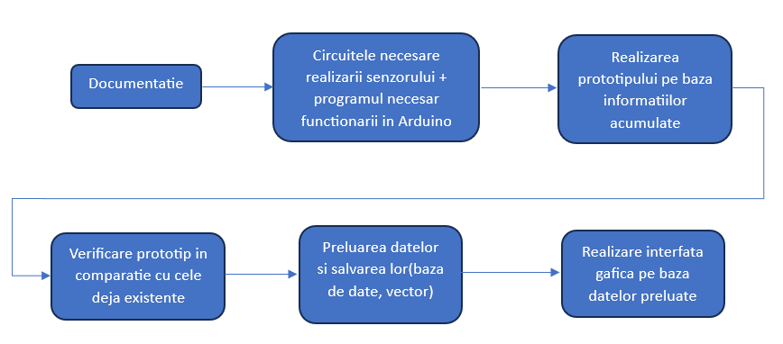

Slide 3
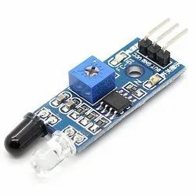
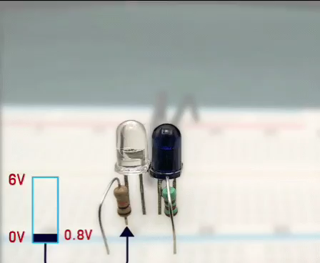
Operating principle
Can be used to measure the heat A object or for proximity .
Those two element vital parts of the composition of this sensor are:
IR LED
IR photodiode
IR LED -> emitter that emits IR radiation
photodiode -> detects just IR radiation
IR emitter generates emission of IR radiation , when these I get to the point , part of the broadcast It is reflect back by the IR receiver . Depending on the intensity the answer how well it was received RECEIVER the emissions , it will be decided what we will had at the exit the sensor . Better said , how much the IR photodiode will receive better radiation emissions , with that may a lot will grow the output voltage of the sensor .

Slide 4
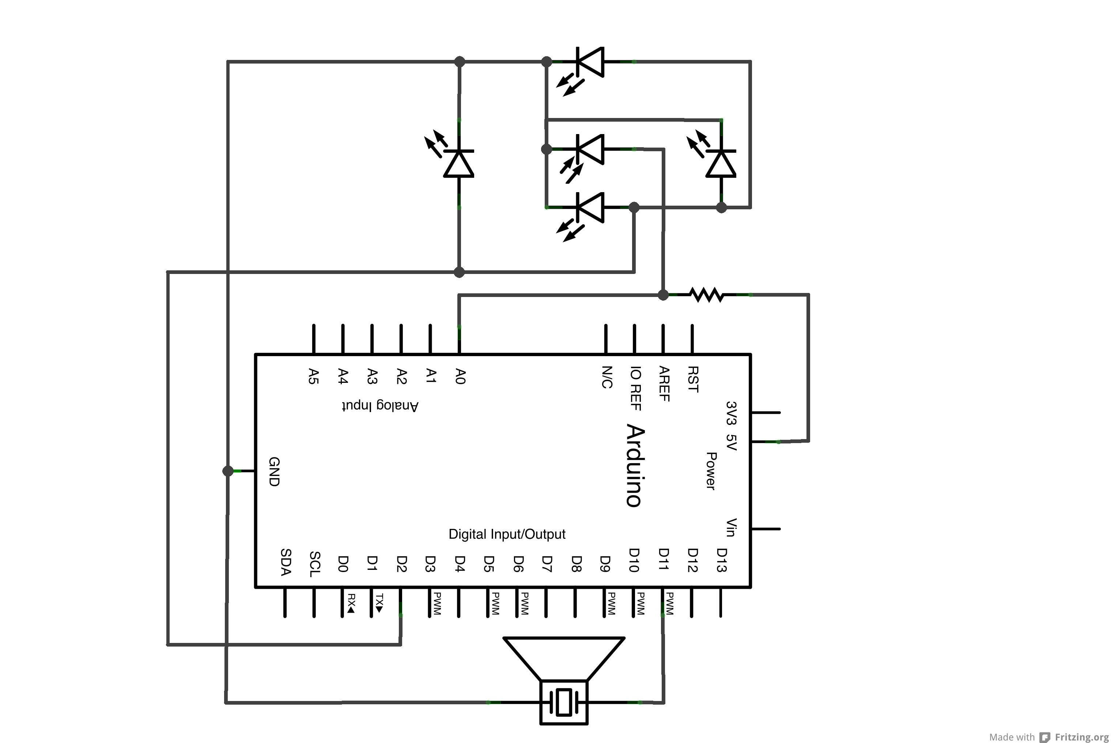

Slide 5
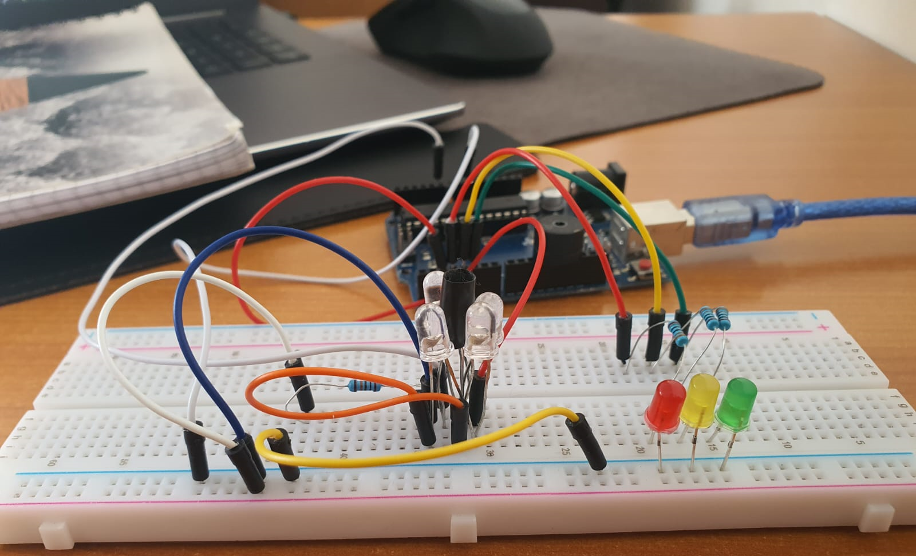

Slide 6
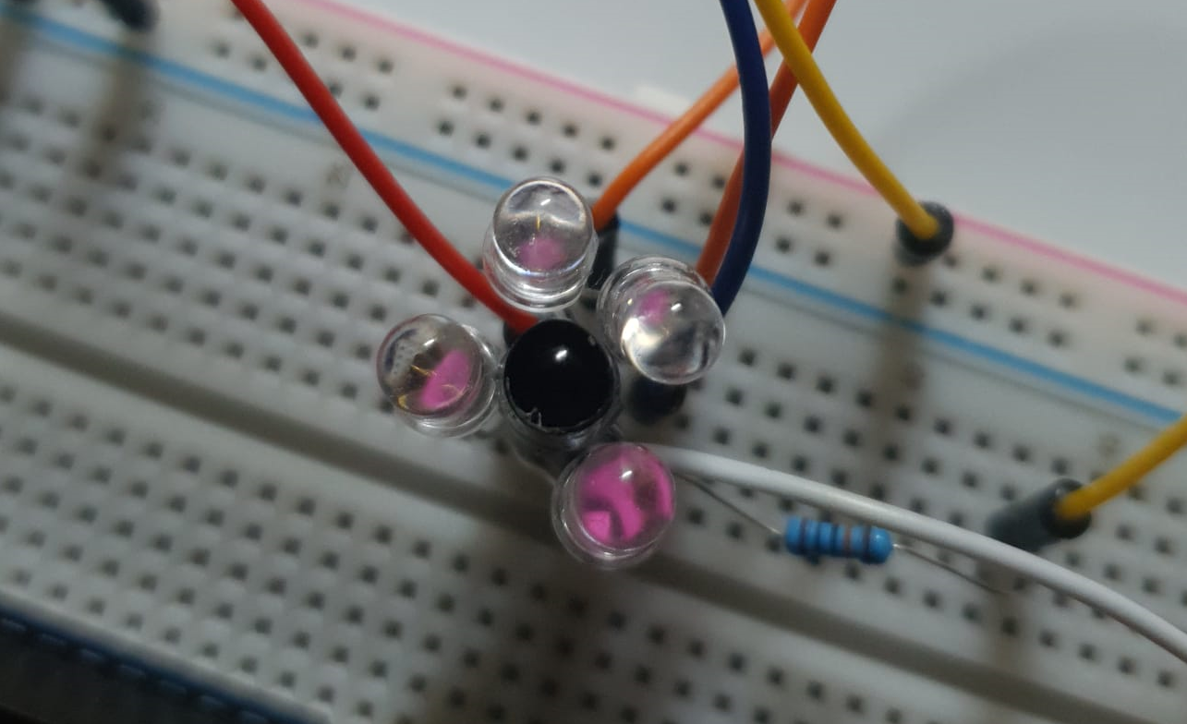

Slide 7
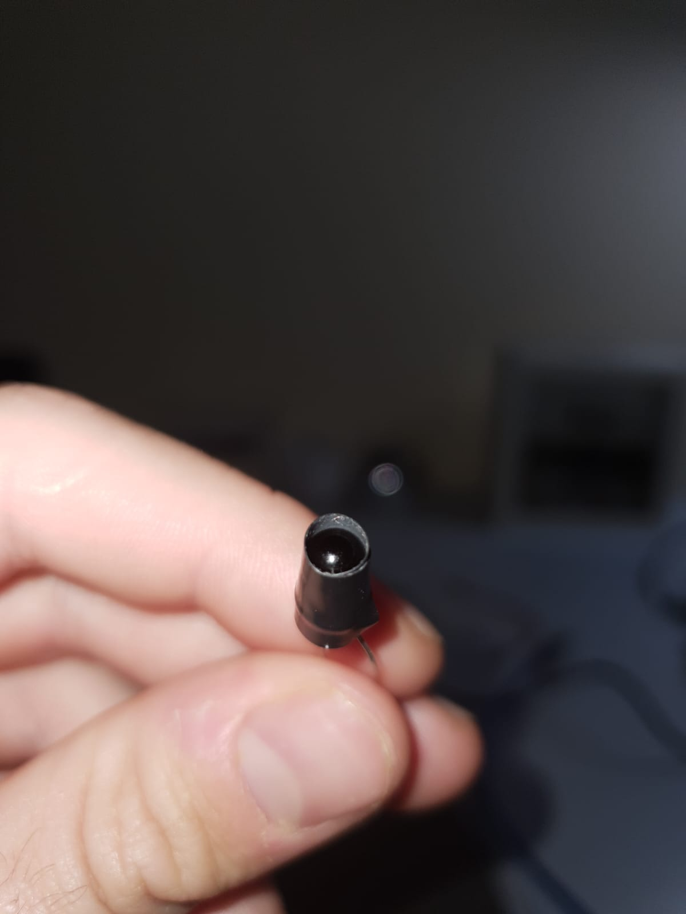
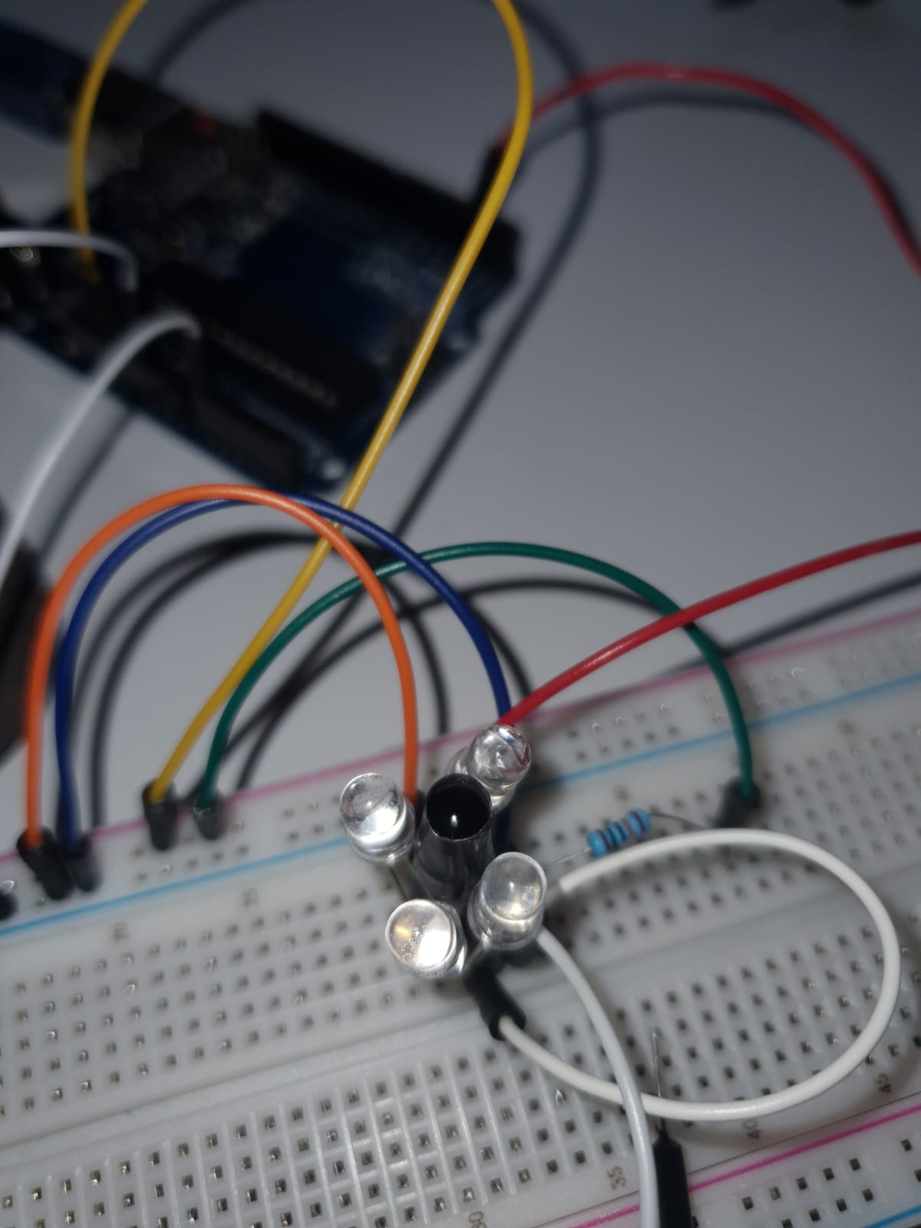
Difficulty ENCOUNTERED
If we put pure and simple transmitter next to the receiver then RECEIVER will the first ones the radiation from the emitter continuously and so will signal as an object It is detected . For solution of This I put problems on the receiver as in the picture .
If we use only one Transmitter then RECEIVER will receive may hard the radiations because it matters very a lot angle from the two components. For solution of this problems I used 4 IR LEDs .
counts a lot and the type of material approaching the senor . Somehow it reacts to a matte material and differently to a glossy material .
Also and the temperature influences the quality results the sensor .

Slide 8
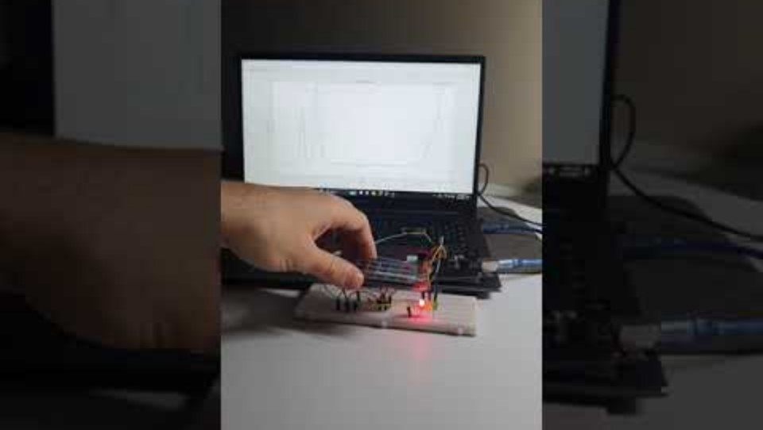
Function

Slide 9
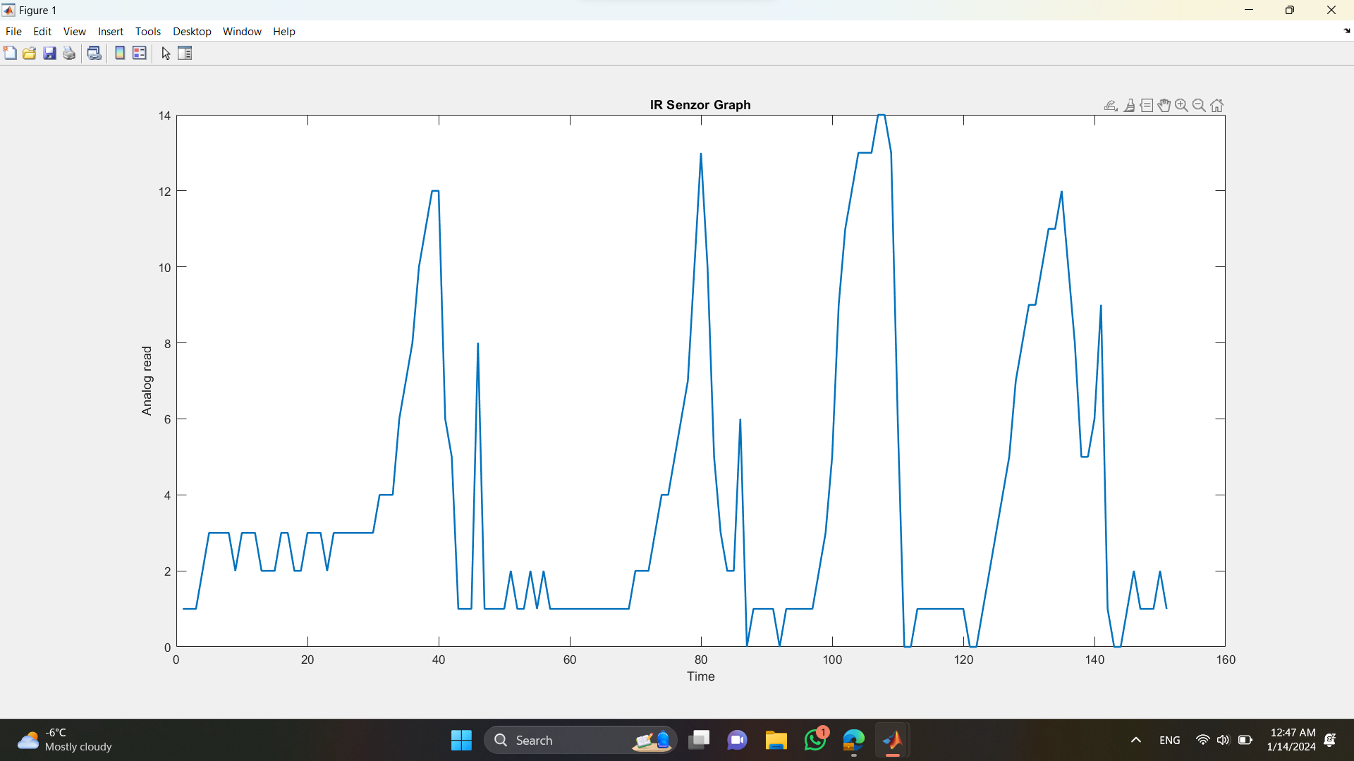
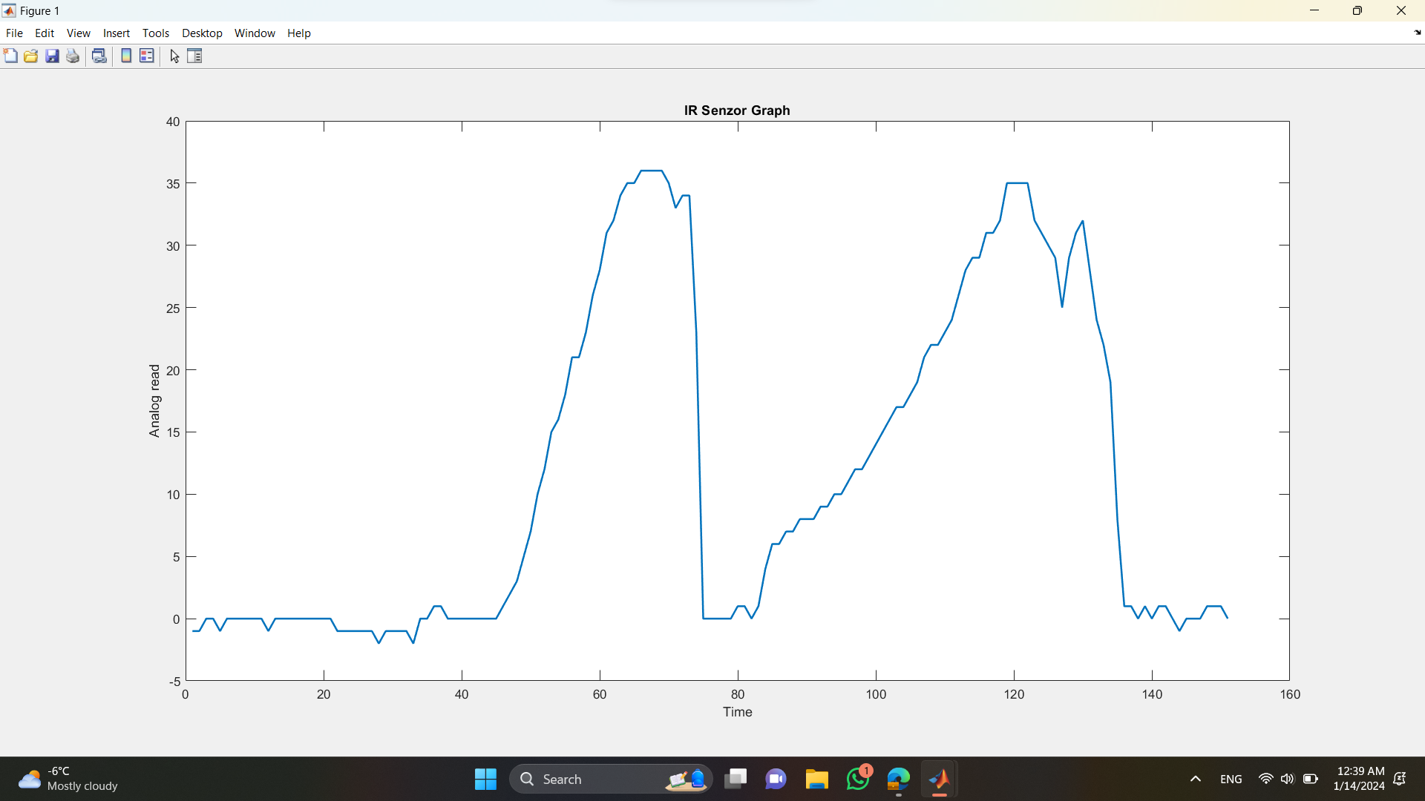
Result
Mat material
Glossy

Slide 10
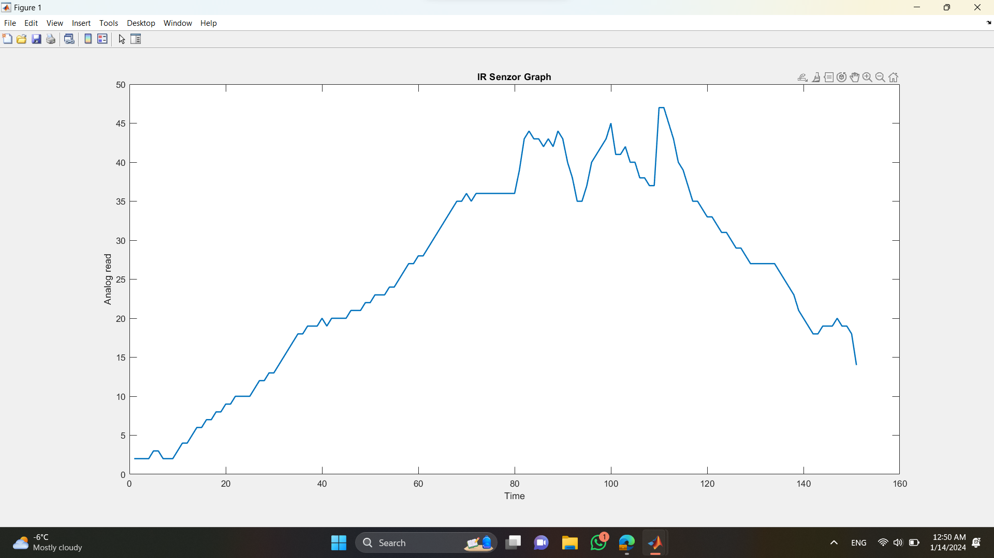
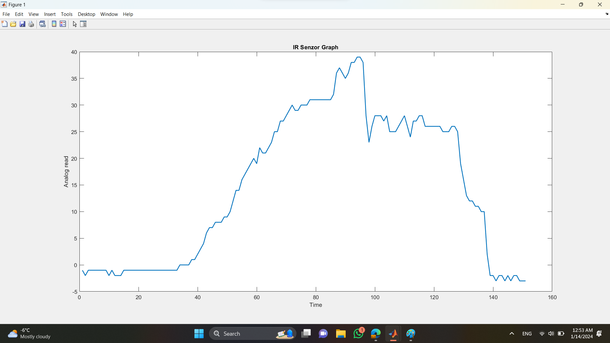
Temperature chamber
The outside

Slide 11
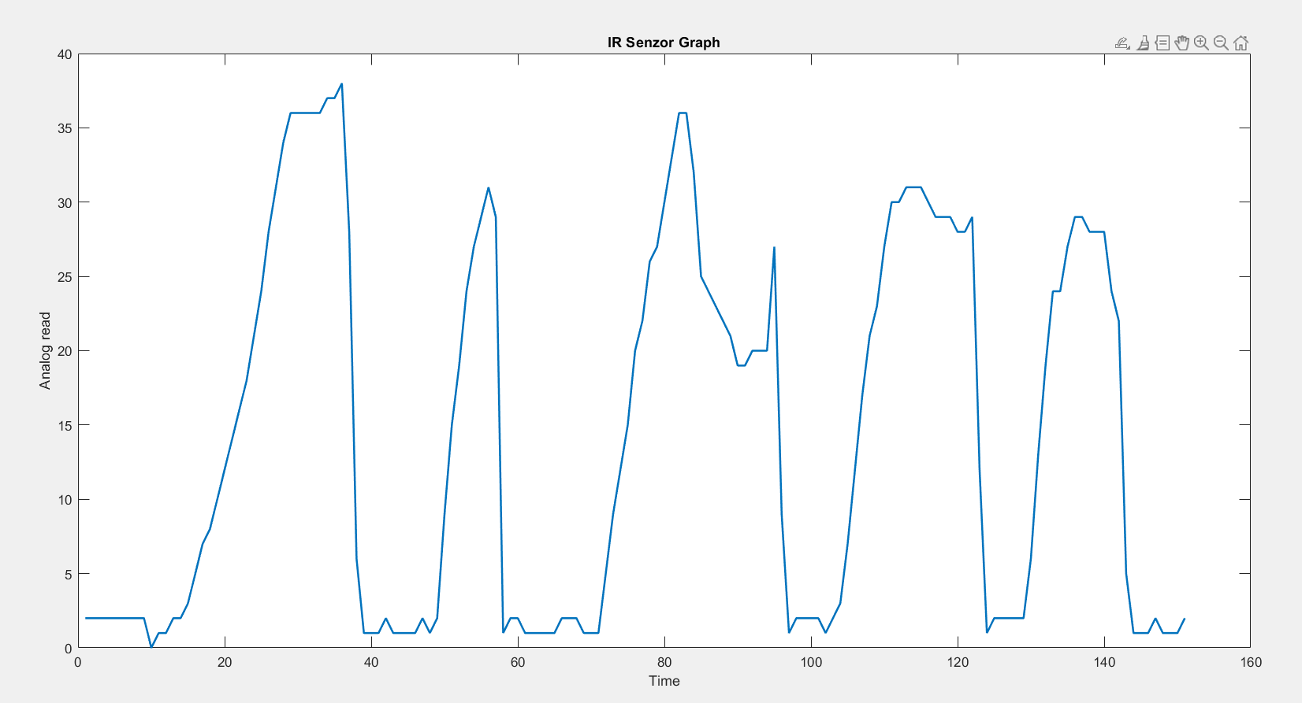
Lights up
Light off

Slide 12
THANK YOU!

